Slide 1
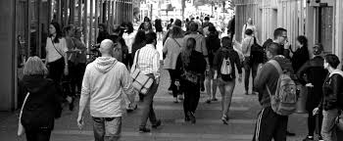
Topic 5: Social influence– How do others affect you?
Revision work book. NAME: ___________________

Slide 2
The Big Picture. You should have learnt about
 | Notes complete or X | RAG | Action
The key terms associated with social influence
Factors that affect bystander intervention
Factors that affect conformity to majority influence
Factors affecting obedience to authority figures
How conformity and obedience influence crowd behaviour
Ways to prevent blind obedience to authority
Social influence studies by Piliavin et al. (1969) and Haney, Banks and Zimbardo (1973)
Issues and debates around social and cultural issues in psychology
Red – Insecure or incomplete I could not answer an exam question on this subject
Amber – Emerging I could have a go at an exam question on this subject but would probably miss some details and
therefore lose some marks.
Green – Secure/confident I could answer an exam question on this subject and achieve full Marks

Slide 3
Terms used in social influence research
Obedience
Conformity
Compliance explained by normative social influence
Internalisation explained by informational social influence
Identification
Deindividuation
Key terms:
Obedience
Authority figure
Conformity
Compliance
Normative social influence
Internalisation
Informational social influence
Identification
Deindividuation

Slide 4
Apply it
Apply it
A group of friends were shown images of how our meat is produced in school. Some did not like the way meat is produced and thought meat processing was unkind to animals. As a result, Olwyn and her friends decided to become vegetarian. Amanda went along with her friends and became a vegetarian, too, but secretly she still wanted to eat meant.
Using your knowledge of types of conformity, explain Olwyn and Amanda’s behaviour. (3 marks)
Complete the table with the correct term for each description. (3 marks)
Description | Term
Although Elliot preferred classical music, he listened to pop music with his friends because they liked it.
Louis saw a person stumble and fall in the street. He thought they must be drunk so he did not stop to help.
When Carolyn put on her police uniform for work she could not be her usual silly and fun-loving self because she was expected to act as a police officer would.

Slide 5
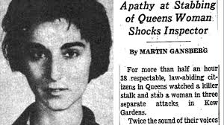
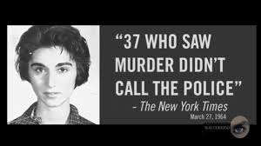
Bystander effect
In 1964, a young woman called Kitty Genovese was brutally murdered outside her New York apartment. Although there were many witnesses to the event, none immediately stepped in to help her.
Psychologists Bibb Latane and JohnDarley explained this as bystander effect (sometimes called bystander apathy) as people’s reluctance to help is because they believe others will help instead. We also look to others to see how to behave, so if no-one else is helping, we will not help either.
Key terms:
Bystander effect

Slide 6
Bystander intervention
Situational factors affecting bystander intervention | Personal factors affecting bystander intervention
Diffusion of responsibility.. | Competence …
Noticing the event … | Mood …
Pluralistic ignorance … | Similarity …
Cost of helping …
Key terms:
Situational factors
Personality factors
Diffusion of responsibility
Pluralistic ignorance
Whether we choose to help someone in need or not is dependent on many factors that can be broadly defined as situational and personal. Situational factors are features of a situation that influence how likely we are to intervene in an emergency. Personality factors are features specific to us (e.g. traits, abilities or feelings) that influence whether we help or not

Slide 7
Psychology in action
Understanding bystander behaviour is very important as it can be used to help prevent bullying. Most bullying occurs when adults are not around, so educating children to intervene to prevent bullying can be really useful. Anti-bullying programmes suggest that children are educated to intervene by understanding the following:
Children should be encouraged to tackle bullying by taking responsibility in a situation and offering help. Children need to understand that it is their responsibility to act rather than wait for someone else to do so.
Children should be encouraged to empathise and understand how it feels to be bullied so that they can feel a connection to the person being bullied.
Children should feel confident that if they intervene it will have a positive outcome and will not negatively impact on them personally.
Apply it
Jerome was shopping in a busy high street when he saw what he thought was a drunken person collapse in the street. Jerome walked past and did not help.
Using your knowledge of situational factors that influence bystander intervention, explain why Jerome failed to help. (3 marks)

Slide 8
Conformity
Situational factors affecting conformity | Personal factors affecting conformity
Size of the majority … | Locus of control …
Unanimity of the majority … | Internal locus of control …
Task difficulty/ambiguity … | External locus of control …
Key terms:
Confederate
Locus of control
Internal locus of control
External locus of control
We conform when we match other people’s beliefs and behaviours because we want to fit in or we do not know how to act in a situation.
Some people are more likely to conform because of the situation they are in, and personality factors also determine whether a type of person is more likely to conform or not.

Slide 9
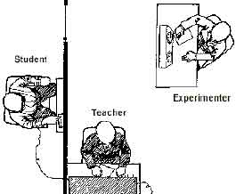
Obedience to an authority figure
Obedience refers to following the orders of an authority figure. This authority figure is typically defined by status, role and/or the ability to use sanctions. A parent can be described as an authority figure because they can remove your pocket money; a police officer has a role of authority recognised by their uniform; and a peer can have greater status in your friendship group.
Obedience is not necessarily a bad thing. We maintain social order by complying with orders, such as wearing school uniform or stopping at a red traffic light. However, some obedience can be considered bad because it may harm another person. Blind obedience occurs when we comply with the order of an authority figure without question. This may be harmful because we fail to reflect on whether our actions are appropriate and fail to take responsibility for such actions.
During the Nazi regime in Germany, many soldiers committed acts of atrocity against millions of innocent Jews, Gypsies and persons that did not support the Nazi government. These soldiers were complying with the orders of their superior officers, often unquestioningly. No one would argue that blind obedience was the sole cause of anti-Semitic attitudes and the Holocaust, however, the soldiers’ blind obedience to authority was a contributory factor.
To test the theory that ordinary people were capable of harming others on the orders of an authority figure, psychologist Stanley Milgram conducted a series of experiments. These experiments tell us a lot about the conditions under which we are more, or less likely to obey.
Key terms:
Blind obedience
Anti-Semitic
Momentum of compliance

Slide 11
Situational factors affecting obedience to an authority figure | other factors that influence obedience
Proximity of the victim ..
Proximity of the authority figure …
Authority figure …
Legitimacy of the context … | Personality factors affecting obedience
Personal responsibility …
Support of others …

Slide 12
Authoritarian personality
The concept of the authoritarian personality came from research by Theodor Adorno et al. (1950). Adorno was attempting to explain the level of anti-Semitism and racism demonstrated by the Nazis during the Second World War. He believed that some people were more inclined to hold anti-Semitic attitudes than others, and that this type of person would display the following characteristics:
Respect for authority figures
Rigid beliefs and attitudes
A strong belief in justice
Right-wing politics
Aggressive to those inferior to themselves
Adorno developed a questionnaire called the F-Scale to test whether someone had an authoritarian personality. Milgram used this questionnaire in an obedience experiment to understand whether the obedient participants had an authoritarian personality and compared them to the disobedient participants. There were 40 participants tested using the F-Scale. The 20 obedient participants gained higher F-Scale scores than the 20 disobedient participants. Milgram concluded that the level of obedience from different participants could have been caused by their personalities.
Key terms:
Authoritarian personality
F-Scale
Another personality factor that may influence obedience is the authoritarian personality. Someone with an authoritarian character tends to be respectful to authority, so is more likely to follow orders.

Slide 13
Apply it
Apply it
A group of five students were given a class test on the capital cities of the world. A multiple-choice question asked for the capital city of Australia. The options were;
Sydney
Canberra
Brisbane
The students discussed the answer and four of them decided to select Sydney as their answer. The fifth student was not sure, but decided that Sydney sounded about right. They all marked Sydney as their answer on the test.
Using your knowledge of types of situational factors affecting conformity, discuss the choice made by the fifth student. (3 marks)
Suki is conducting an obedience study. Participants are ordered to walk around a room and criticise people for not completing their jigsaw fast enough. They are ordered by a stern-looking teacher to continue to criticise and harass the people.
Using your knowledge of situational factors that influence obedience , explain the likely findings of Suki’s experiment. (6 marks)

Slide 14
Understanding the behaviour of crowds
Understanding the behaviour of crowds
Deindividuation and conformity | Obedience
Key terms:
Prosocial behaviour
Antisocial behaviour
There are many different types of crowd; some are peaceful and some are destructive. Peaceful crowds can be found at festivals, concerts and sporting events – even protests can be peaceful. In such cases, crowds can show prosocial behaviour. However, some crowds can start off as, or develop into, mobs – from which rioting can arise. In this instance, the crowd can be described as showing antisocial behaviour.

Slide 15
Apply it.
Bessie conducted an experiment to investigate crowd behaviour. She asked individuals and small and large groups of people to decide how much hot sauce to give another person. The hot sauce was painful to taste. The results of her investigation are shown in table below:
Using your knowledge of obedience and conformity in understanding antisocial behaviour of crowds, explain Bessie’s results. (4 marks)
Type of grouping | Amount of hot sauce
Individual | 10 mls
Small group of 3 | 20 mls
Large group of 10 | 35 mls

Slide 16
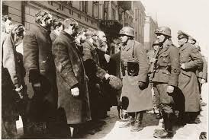
Understand ways to prevent blind obedience to authority figures
Ways to prevent blind obedience to authority
Social support
Familiarity of the situation
Distance
Education
Milgram’s research into obedience not only tells us when we are more likely to obey an authority figure, it also tells us when we are less likely to obey. In order to prevent blind obedience to authority, it is important to understand these factors and use this knowledge in society.

Slide 17
Apply it. Although aeroplane accidents are relatively uncommon, a review of accidents over a 10 year period found that the first officer not being willing to question a decision made by the captain contributed to more than 20 per cent of the accidents.
Using your knowledge of ways of preventing blind obedience, explain how these accidents could be prevented in the future. (4 marks)

Slide 18
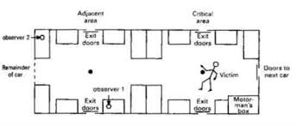
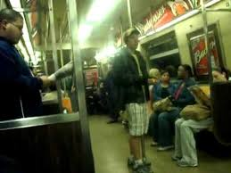
Piliavin et al. (1969) Good Samaritanism: An underground phenomenon?
AIM
PROCEDURE
RESULTS
CONCLUSION
EVALUATION

Slide 19
Draw a storyboard to retell the research carried out by Piliavin et al. (1969) Good Samaritanism: An underground phenomenon?

Slide 20
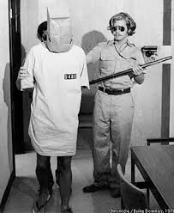
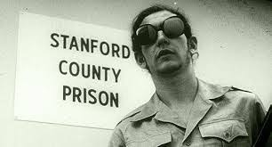
Haney, Banks and Zimbardo (1973) A study of prisoners and guards in a simulated prison
AIM
PROCEDURE
RESULTS
CONCLUSION
EVALUATION

Slide 21
Draw a storyboard to retell the research carried out by Haney, Banks and Zimbardo (1973) A study of prisoners and guards in a simulated prison

Slide 22
Issues and debates Social and cultural issues in psychology
Social issues in psychology
Society refers to…. | A social issue is a ….
Cultural issues in psychology
Culture refers to……..
Individualistic cultures typically … | Collectivistic cultures typically …
Key terms
Society
Social issue
Culture
Individualistic culture
Collectivistic culture

Slide 23
Social issues in psychology |  | Cultural issues in psychology
 | Obedience
 | Conformity
 | Deindividuation
 | Bystander effect

Slide 24
Exam – style question
Assess how culture influences group behaviour. Use concepts, theory and research from social influence in your answer. (9 marks)
‘Group behaviour’ is quite open and can refer to conformity, crowd behaviour and bystander effect, so there is plenty of scope to refer to different explanations and theories. Remember to present an idea and where possible ‘assess’ the research evidence or concept described.
For this question, you will need to judge whether culture does actually have an influence on how we behave in groups, so a two-sided view would strengthen your answer.
Exam tip
‘Assess’ questions require extended writing, featuring full sentences and paragraphs to clearly separate out your ideas.
You should plan your answer before you start to make sure you do not leave out something important when you are writing.

Slide 25
Assess how culture influences group behaviour. Use concepts, theory and research from social influence in your answer. (9 marks)

Slide 26
Obedience
Authority figure
Conformity
Compliance
Normative social influence
Internalisation
Informational social influence
Identification
Deindividuation
Bystander effect

Slide 27
Situational factors
Personality factors
Diffusion of responsibility
Pluralistic ignorance
Confederate
Locus of control
Internal locus of control
External locus of control
Blind obedience
Anti-Semitic

Slide 28
Momentum of compliance
Authoritarian personality
F-Scale
Prosocial behaviour
Antisocial behaviour
Field experiment
Covert observation
Ecological validity
Demand characteristics
Generalisability

Slide 29
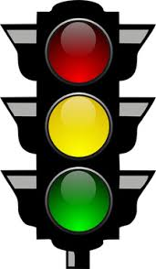
Society
Social issue
Culture
Individualistic culture
Collectivist culture
Key terms that are RED or AMBER for me and I need to concentrate on memorising them accurately:

